Slide 1


Slide 2

PROPHET
TIME SERIES
AVOCADO
MARKET PREDICTION

Slide 3
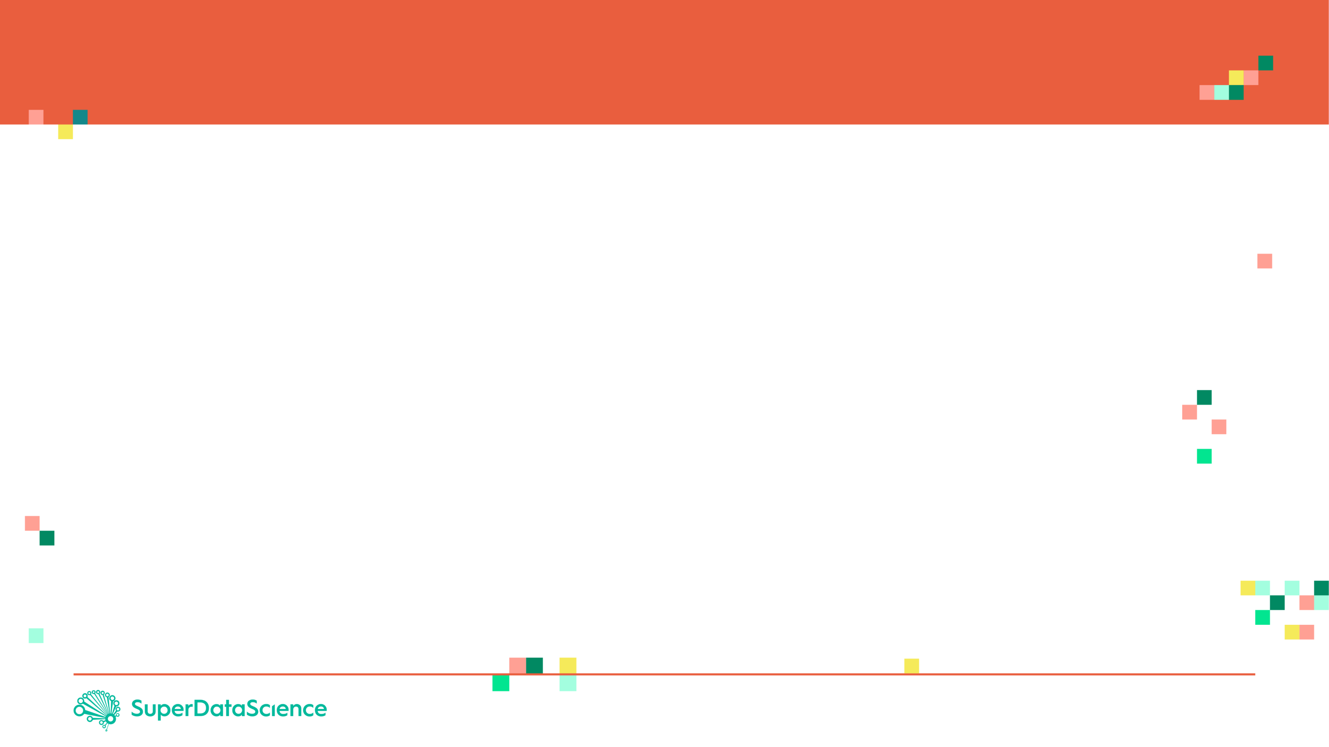
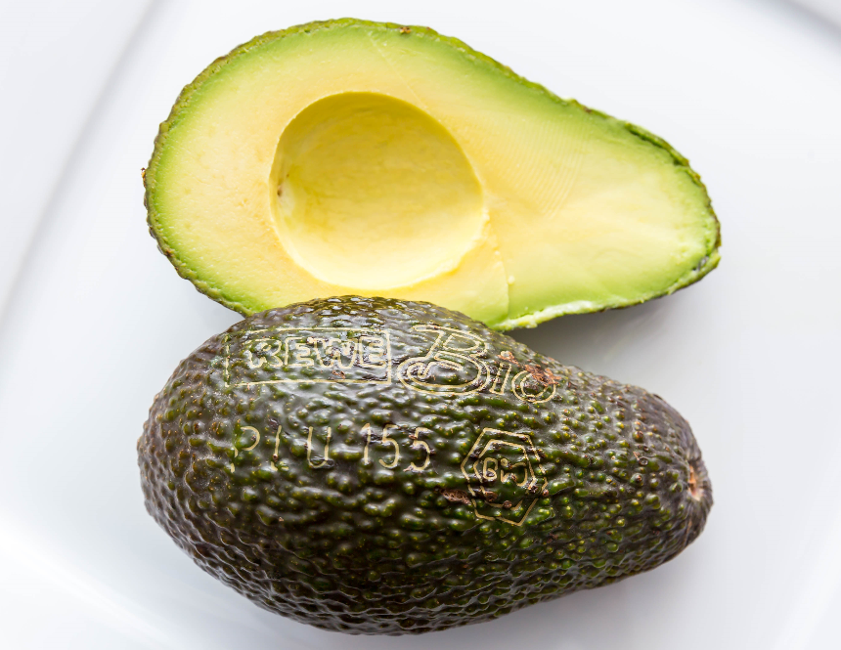
PROJECT OVERVIEW
The objective of this case study is to predict the price of avocado sold in the US using historical dataset.
Data represents weekly 2018 retail scan data for National retail volume (units) and price.
The data is as follows:
Date - The date of the observation
Average Price - the average price of a single avocado
type - conventional or organic
year - the year
Region - the city or region of the observation
Total Volume - Total number of avocados sold
4046 - Total number of avocados with PLU 4046 sold
4225 - Total number of avocados with PLU 4225 sold
4770 - Total number of avocados with PLU 4770 sold
*The Product Lookup codes (PLU’s)
Image Source: https://www.flickr.com/photos/30478819@N08/33063122713

Slide 4
PROPHET
TIME SERIES
WHAT IS FACEBOOK PROPHET?

Slide 5
FACEBOOK PROPHET
Prophet is open source software released by Facebook’s Core Data Science team.
Prophet is a procedure for forecasting time series data based on an additive model where non-linear trends are fit with yearly, weekly, and daily seasonality, plus holiday effects.
Prophet works best with time series that have strong seasonal effects and several seasons of historical data.
For more information, please check this out:
https://research.fb.com/prophet-forecasting-at-scale/
https://facebook.github.io/prophet/docs/quick_start.html#python-api
NOTE:
You must install fbprophet package as follows: pip install fbprophet
If you encounter an error, try: conda install -c conda-forge fbprophet

Slide 6

FACEBOOK PROPHET
Prophet implements an additive regression model with four elements:
A piecewise linear, Prophet automatically picks up change points in the data and identifies any change in trends.
A yearly seasonal component modeled using Fourier series.
A weekly seasonal component.
A holiday list that can be manually provided.
Additive Regression model takes the form:
$$Y=β_{0}+\sum_{j=1}^{p}{f_{j}\left(X_{j}\right)+ε}$$
The functions $f_{j}(x_{j})$ are unknown smoothing functions fit from the data
Reference: https://research.fb.com/prophet-forecasting-at-scale/

Slide 7
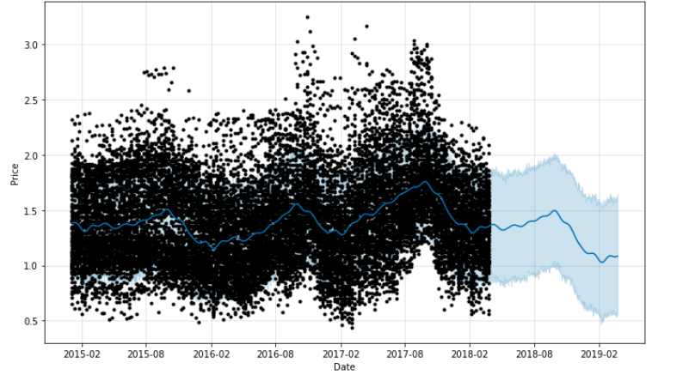
FACEBOOK PROPHET EXPECTED OUTPUT
Expected Outcome:
FUTURE
PAST

Slide 8
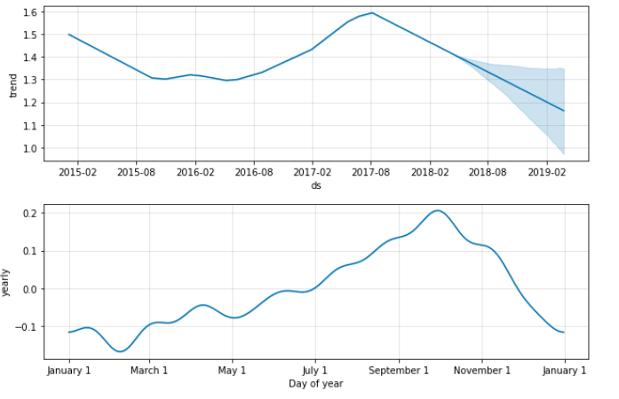
FACEBOOK PROPHET EXPECTED OUTPUT

